Slide 1
Hello Virtual Environment Development`
5CM503 Virtual Environment Development
Dr Patrick Merritt

Slide 2
Contents
Introduction
Who am I?
What is VED?

Slide 3
Who am I?
You should all know me by now, but just in case…
Dr Patrick Merritt
MS 308
Generally, on Site Monday, Tuesday and Thursday.
Open door policy, come say hi, headphones are usually just for music.
Email:- p.merritt@derby.ac.uk
Email responses are up to two working days, if you have not heard back with two working days, it is acceptable to send a reminder.
Teams:- Same as my email or click!
Teams is generally faster, got a question? Ask it here!

Slide 4
Last minute switch
I am currently covering for Chris Windmill
He will take over at some point, I will keep you up to date as I get more information.

Slide 5
Lab / lecture schedule
1 Hour lecture a week for 24 weeks.
1 whole day of your life will be spent listening to me.
3 hours lab each week.
These are shared with 2 other modules, graphics and real time environment development.
Rotates weekly, starting with game engine systems.
I will try and be available for all sessions, but I will at the very least be there in sessions 1, 4, 7, and 10 in term 1. (Term 2 to be confirmed based on schedules).

Slide 6
What is VED
It is the process of creating virtual environments
How does the world we are playing come to be?
How do we design it?
How does it get built?
What do I need to know?

Slide 7
Planning…
For the most part, in most modules so far you have been given a clearly defined goal and been told what you must achieve.
Here you have a much more free reign of what you must build based only on a theme.

Slide 8
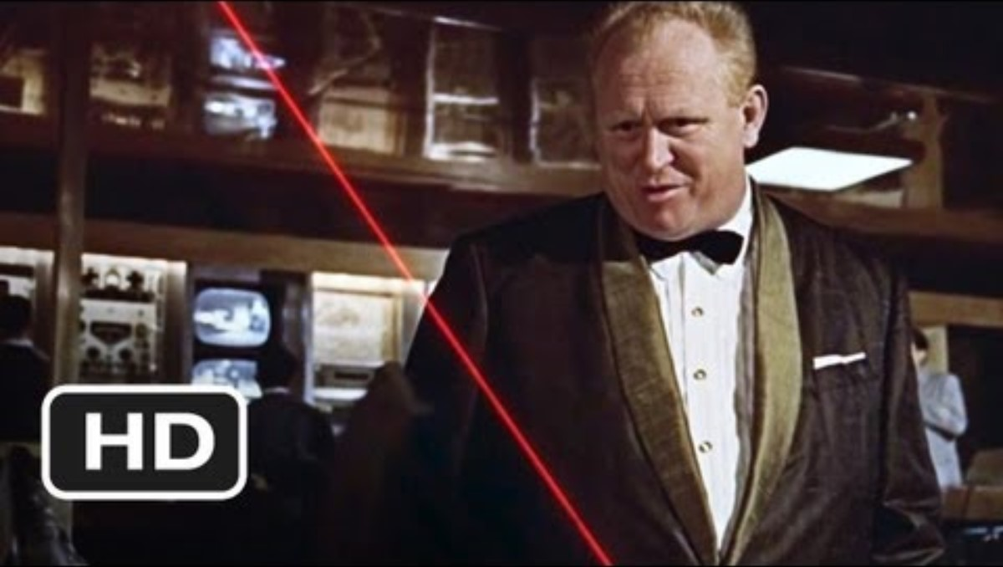
The Theme

Slide 9
NO! I expect you to die!
This is your “seed” to provide some inspiration.
The statement not to movie clip!
You will design and build one full level of the game.
You must include at least one “combat” element in the final game.
Other than that, pretty much build whatever you game.

Slide 10
What do we mean by combat?
Something adversarial…
So, the traditional bullet meets bad guy easily meets the brief.
But so would a card battle…
So would Mario-style boss battles…
Quite a few options here, if in doubt ask!

Slide 11
The Coursework
One big one, lots of writing…

Slide 12
Component 1) Design and build a level
This component requires you to go through the level design process from creating a level description from a simple brief, through layout, block out and grey-box models before looking at the impact of lighting on performance and perception.

Slide 13
Component 1) cont…
A brief description (500 words maximum) of the environment you plan to build with supporting images (may be AI generated) showing the look and feel of the environment.
• A layout diagram for your level showing points of interaction, interest, combat, and other relevant factors.
• A white box/block out of your level using primitive models.
• A grey box of your level replacing the primitive models with sourced/created assets.
• Lighting applied to the grey-box model demonstrating the appropriate use of static, stationary, and dynamic lighting.
• A short critical review (500 words maximum) of your work, optionally a peer review (250 words maximum).

Slide 14
Component 2) Gameplay Interactions
This component requires you to develop gameplay and character mechanics that interact with your level design and demonstrate your ability to design and test mechanics within a prototype environment.
A brief description (500 words maximum) of your planned interactions demonstrating appropriate use of interactions with single and multi-stage events.
An interactive and real-time instance of your [component 1] level or a level provided by your tutor.
A set of character mechanics that interact with the level design.
A set of gameplay mechanics that define the style and feel of the game.
A gameplay interaction.
A short critical review (500 words maximum) of your work, optionally a peer-review (250 words maximum).

Slide 15
Advice, document everything…
A lot of the work for the assignments for this module is reports.
Yes, with references supporting your arguments.
Building the thing is not enough, you must be able to document and discuss why…
I advise you to keep a development diary where you write down the key decisions and choices you make and WHY you made them.
I Believe Chris has set this up as a long slow burn with one delivery point.

Slide 16
Plan
Step one:- Plan everything.

Slide 17
We sort of did this last year…
We looked at the game design document last year in a very superficial manner.
Got you to start thinking about the planning process.
But let’s be honest most of you did it after the fact
I’m OK with that.
Now let’s engage with this process properly…

Slide 18
The GDD
As a minimum 4 key parts.
The Executive
The Description
The Target
The Plan

Slide 19
The Executive Pitch
1 or 2 paragraphs that explain the game idea and its USP to an interested party.
USP = Unique selling point. The thing that makes people want to play your game.
Doesn’t necessarily need to be “original” but it’s the “unique” thing you are providing.
Justify why someone, as a player, would invest in this game.
If you find you can’t explain your idea here, it’s probably not defined well enough.
An overview so only the important details.

Slide 20
The Description
Describe the game IN DETAIL...
No such thing as too much detail but start with the easy stuff and work outwards.
Genre, theme and mechanics
Genre is the type of game (RPG, FPS).
Theme is the setting for your game (Western, Futuristic).
Mechanics refer to the key gameplay actions (Wall running, Dodging, singing)
https://firith.studio/game-idea-generator

Slide 21
Details…
The details you add will depend on the game you are making.
A platformer game such as Mario will probably have a pretty extensive character design section.
Open-world games and RPGs probably have extensive Lore and setting documentation.
Puzzle games probably have highly detailed mechanics descriptions.

Slide 22
Pillars
At this point, it’s usually a good idea to define the pillars of the game as part of the description.
What is your game going to be known for?
Usually at least 3
Form single-sentence statements.
A studio can also have pillars, what are the studio’s games known for?

Slide 23

Super Mario Odyssey
Pillars from the game?
Pillars from the studio?

Slide 24
The Target
Define who you are making the game for and why they would want to play it.
If you cannot justify a player base, you should question why you should make this!
This doesn’t mean a monetisation plan, not all products need this, but it can form part of this.

Slide 25
The plan
The most important part.
Given the time and resources you have OR the time and resources you are requesting…

Slide 26
The plan
The most important part.
Given the time and resources you have OR the time and resources you are requesting…
Can you build this?

Slide 27
The plan
The most important part.
Given the time and resources you have OR the time and resources you are requesting…
Can you build this?
If so prove it!

Slide 28
Is it technically possible?
The answer to this should be either yes or maybe…
If the answer is no, then you need to replan, you can’t plan to do something you can’t do!
Define what major technical challenges you have and how you plan to overcome them.
You can have a little bit of an unknown here, but you should have a plan to solve these
And a plan for what happens if it turns out to be impossible!

Slide 29
Is it temporally possible?
Can I complete this in time?
If the answer is no, then you need to cut features or scrap the project.
Must be reasonable
There is no point in planning a project based on an unrealistic work pattern.
If you don’t plan to work Christmas day…
DON’T SCHEDULE WORK TO BE COMPLETED ON CHRISTMAS DAY!
Again, the answer should be maybe, but you should again have a plan to mitigate this risk.
What do you do when things take longer?

Slide 30
Is it a living document?
Can I change it?
Some say yes, some say no…
I say yes, BUT do the first plan at the start and compare it to the end plan and result.
Easy reflective marks in the report ;)

Slide 31
Homework!
Start the plan! A basic plan should take a couple of hours.
I will review these in Lab 2 or 3…
I will help you determine if the idea is feasible and add detail to the plan.
If you don’t do this now you will regret it later…
Trust me.

